Slide 1

Formula 1
Kaloyan Rakov

Slide 2
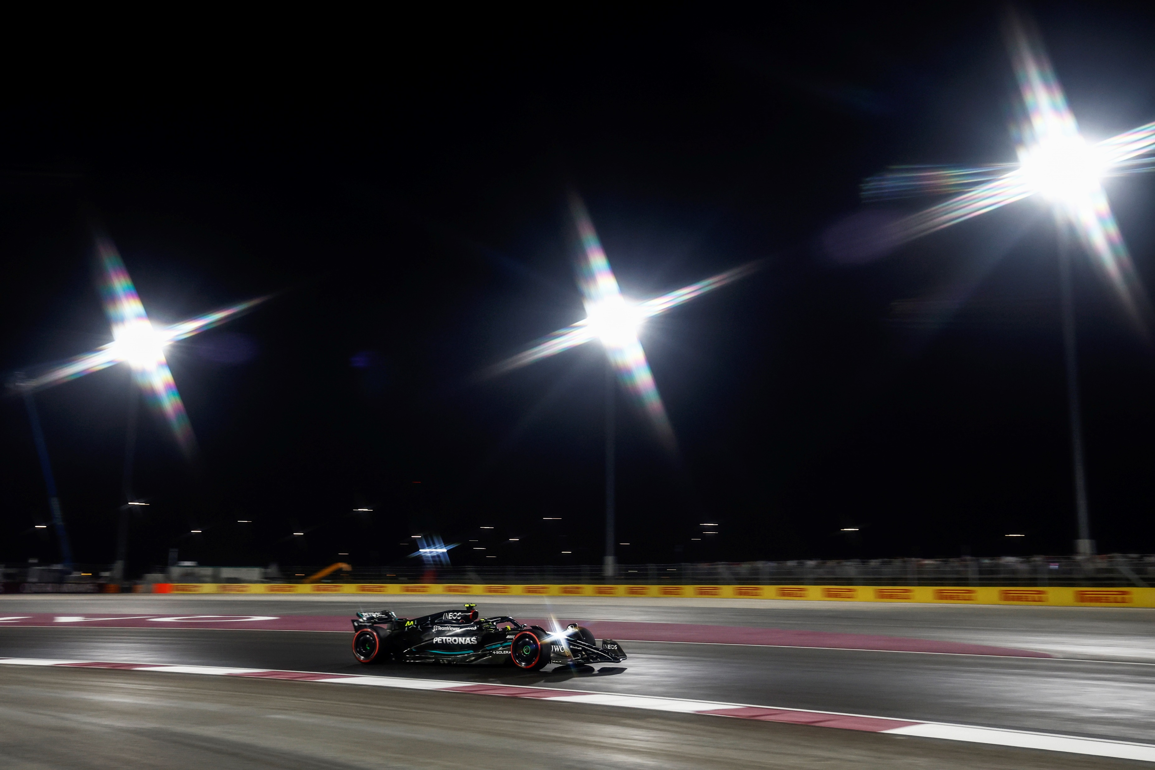
Project
Goal

Slide 3
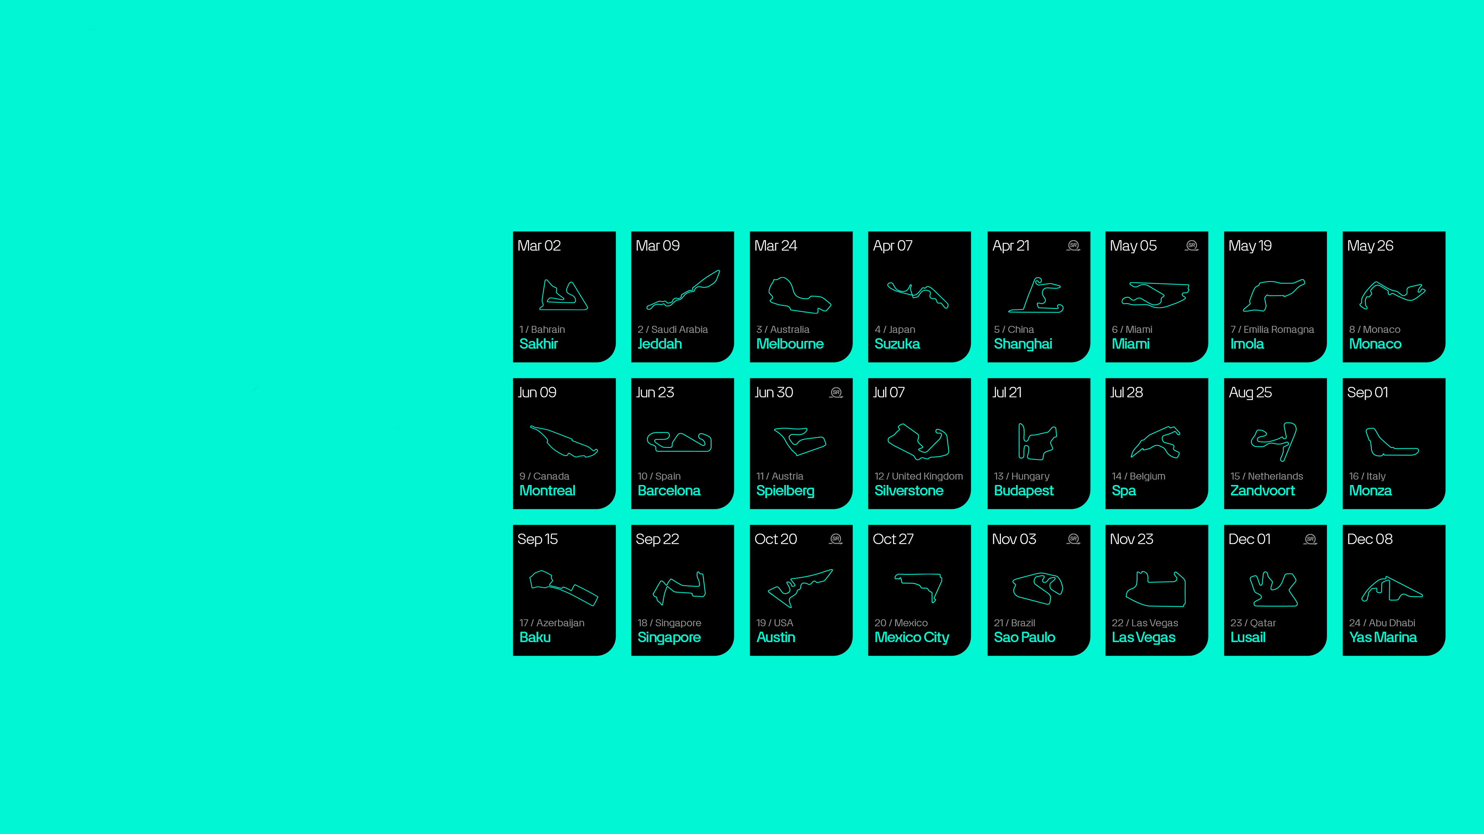
Dataset Overview
2024 Season
2025 Qualifiers (Per Race)
Starting Grid
Real Team/ Indiv. Results
*2024 Season Calendar

Slide 4

Modelling
K-Nearest Neighbours
Linear Regression
Decision Trees
Support Vector Regressor
Random forest

Slide 5
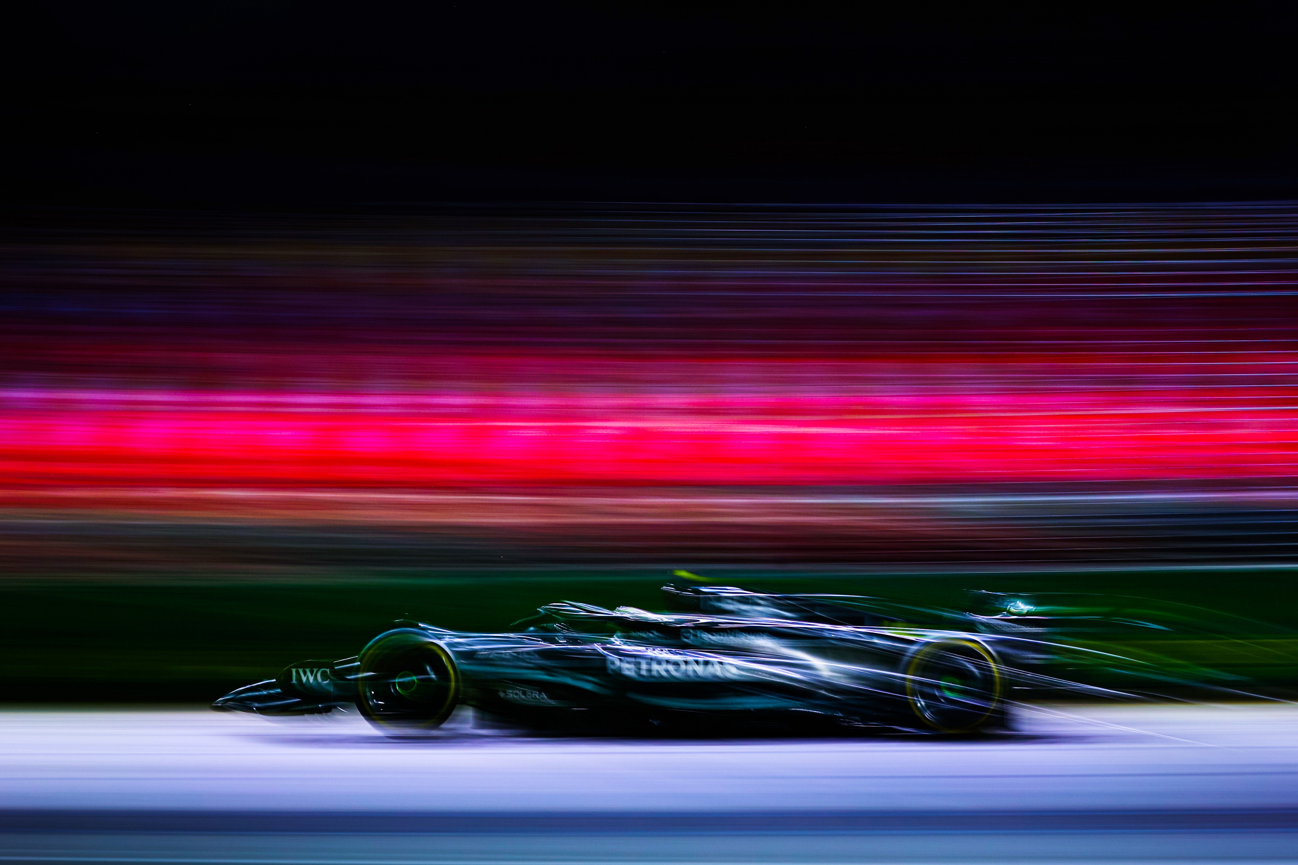
Dashboard

Slide 6
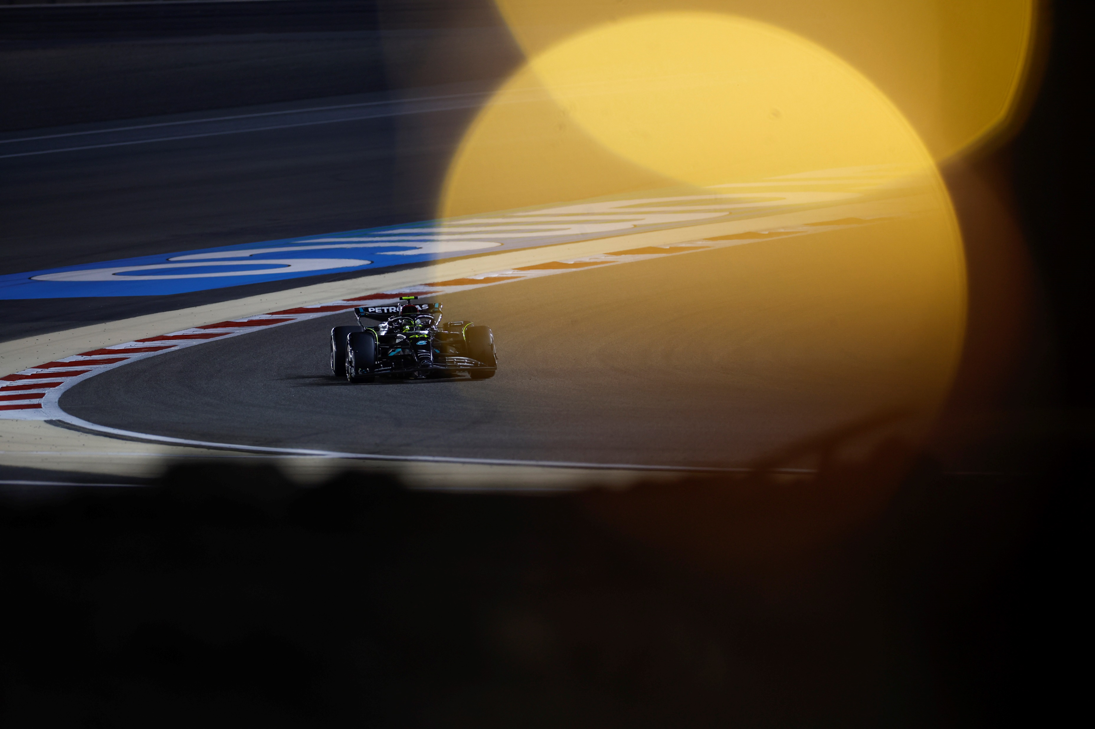
Conclusion

Slide 7
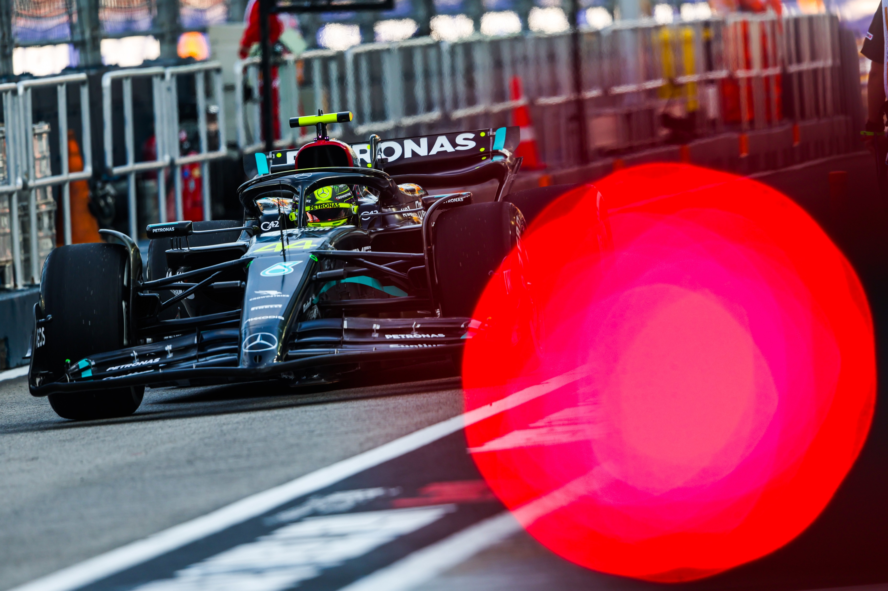
Thank you for your attention

